Slide 1
Oxfords e-lesson 4
Grade : Basic 9(Revision)
Subject : Mathematics
Topic : Variation

Slide 2
Salient point
Partial variation
In handling problems involving partial
variation, there are two statements/
phrases that will help us identify partial
variation problems. The statements are
Party Constant
Partly Varies

Slide 3
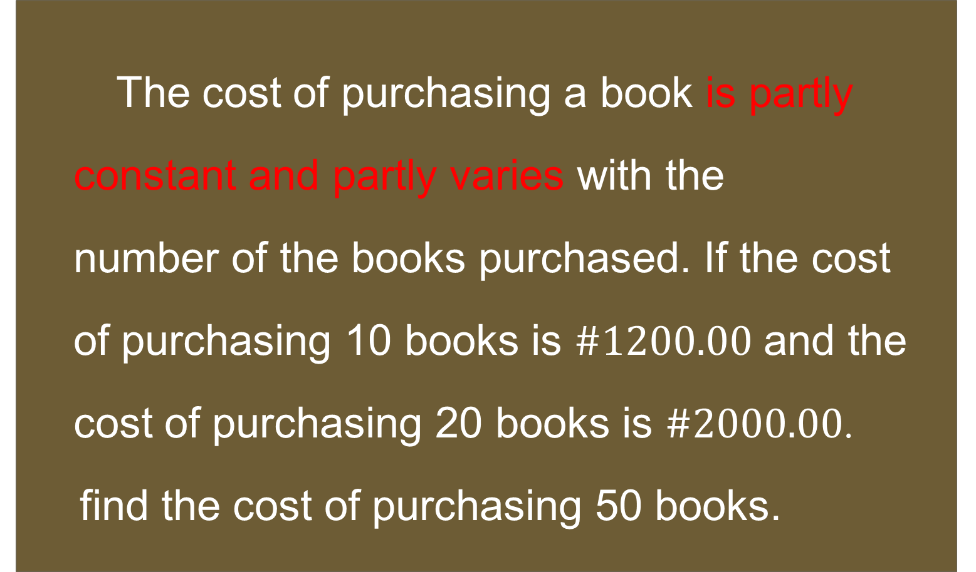
Question 1
The cost of purchasing a book is partly
constant and partly varies with the
number of the books purchased. If the cost
of purchasing 10 books is $\#1200.00$ and the
cost of purchasing 20 books is $\#2000.00$.
find the cost of purchasing 50 books.

Slide 4
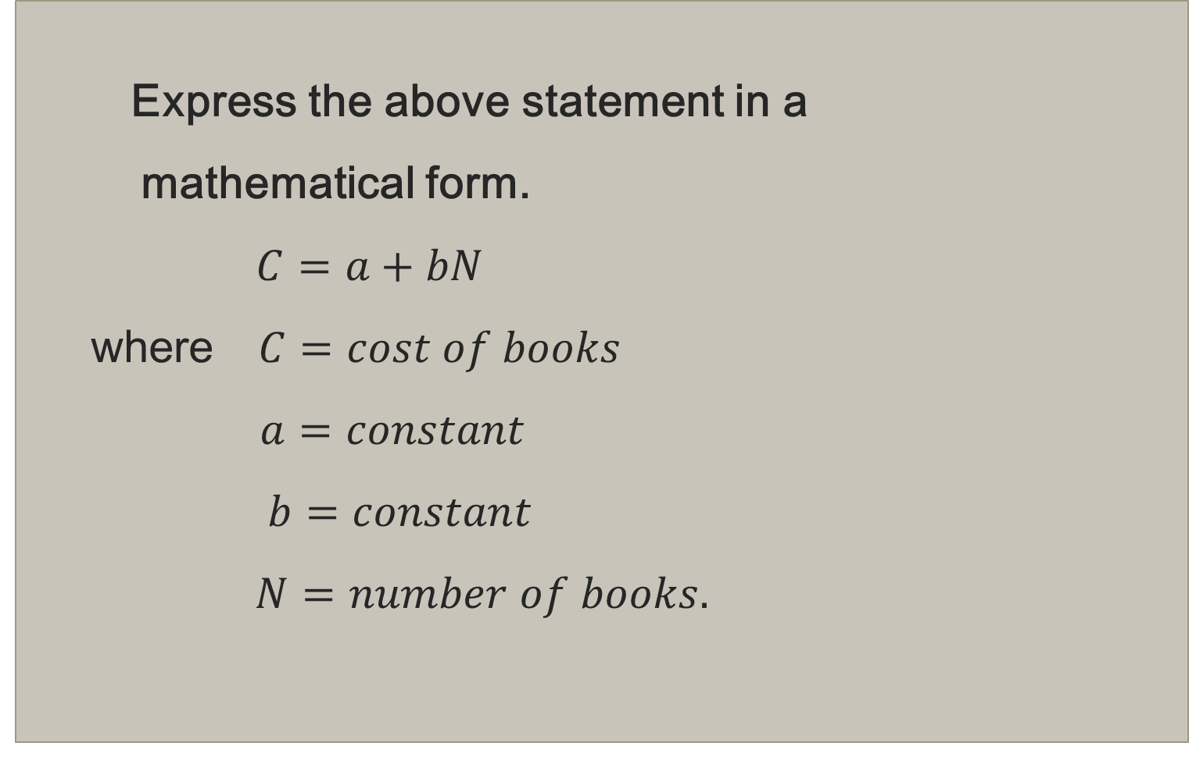
Solution
Express the above statement in a
mathematical form.
$C=a+bN$
where $C=cost of books$
$a=constant$
$b=constant$
$N=number of books.$

Slide 5
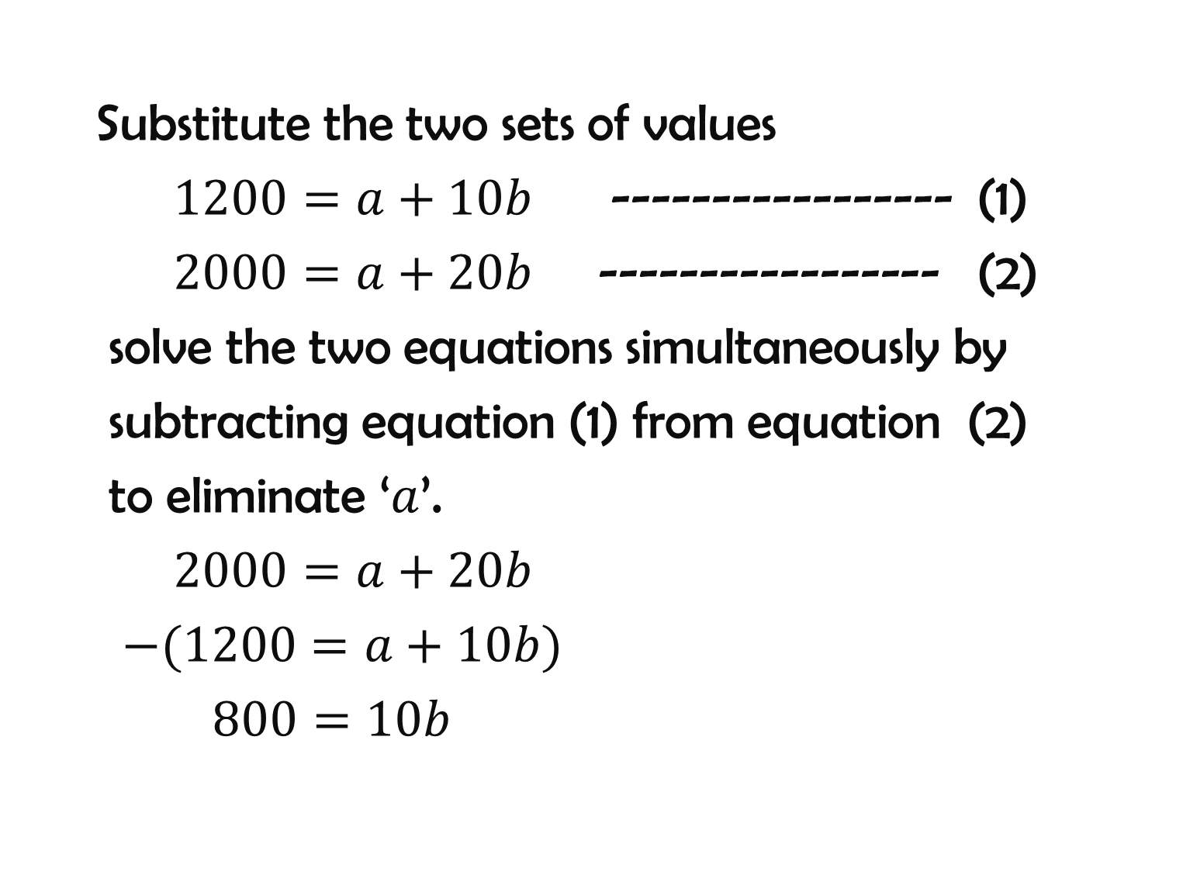
Substitute the two sets of values
$1200=a+10b$ ----------------- (1)
$2000=a+20b$ ----------------- (2)
solve the two equations simultaneously by
subtracting equation (1) from equation (2)
to eliminate ‘$a$’.
$2000=a+20b$
$−(1200=a+10b)$
$800=10b$

Slide 6
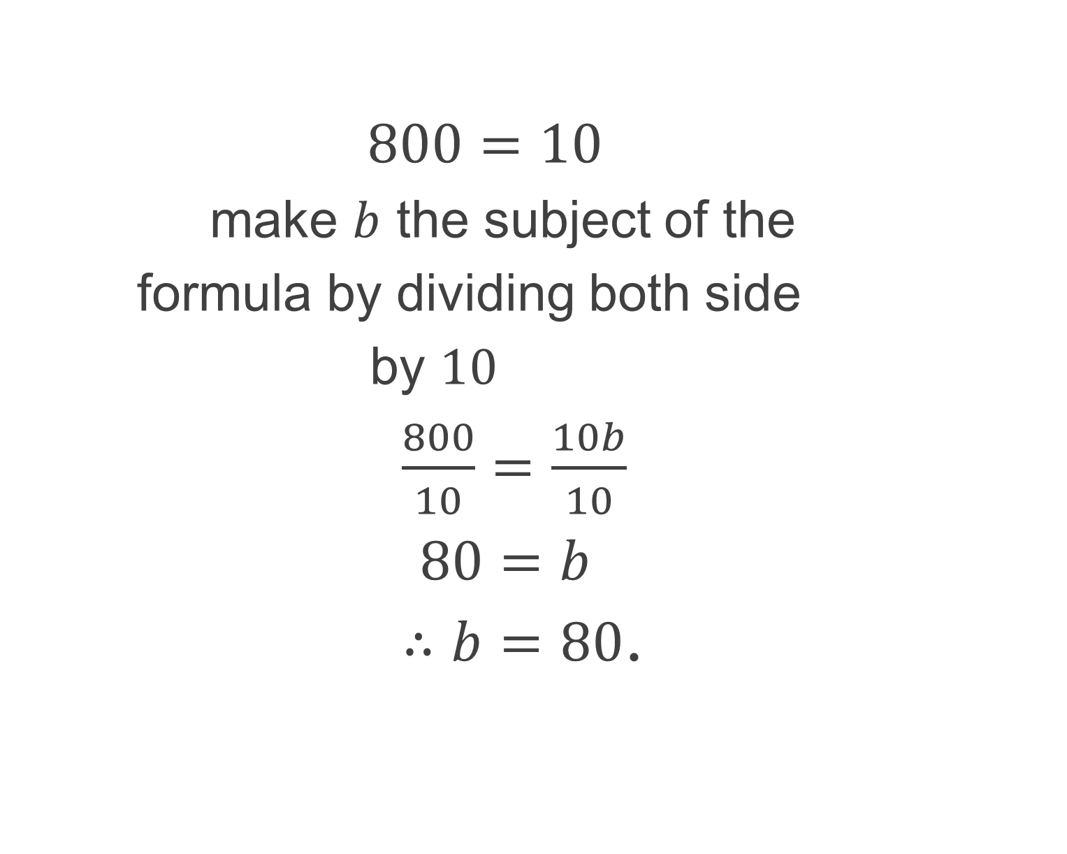
$800=10$
make $b$ the subject of the
formula by dividing both side
by $10$
$\frac{800}{10}=\frac{10b}{10}$
$80=b$
$∴b=80$.

Slide 7
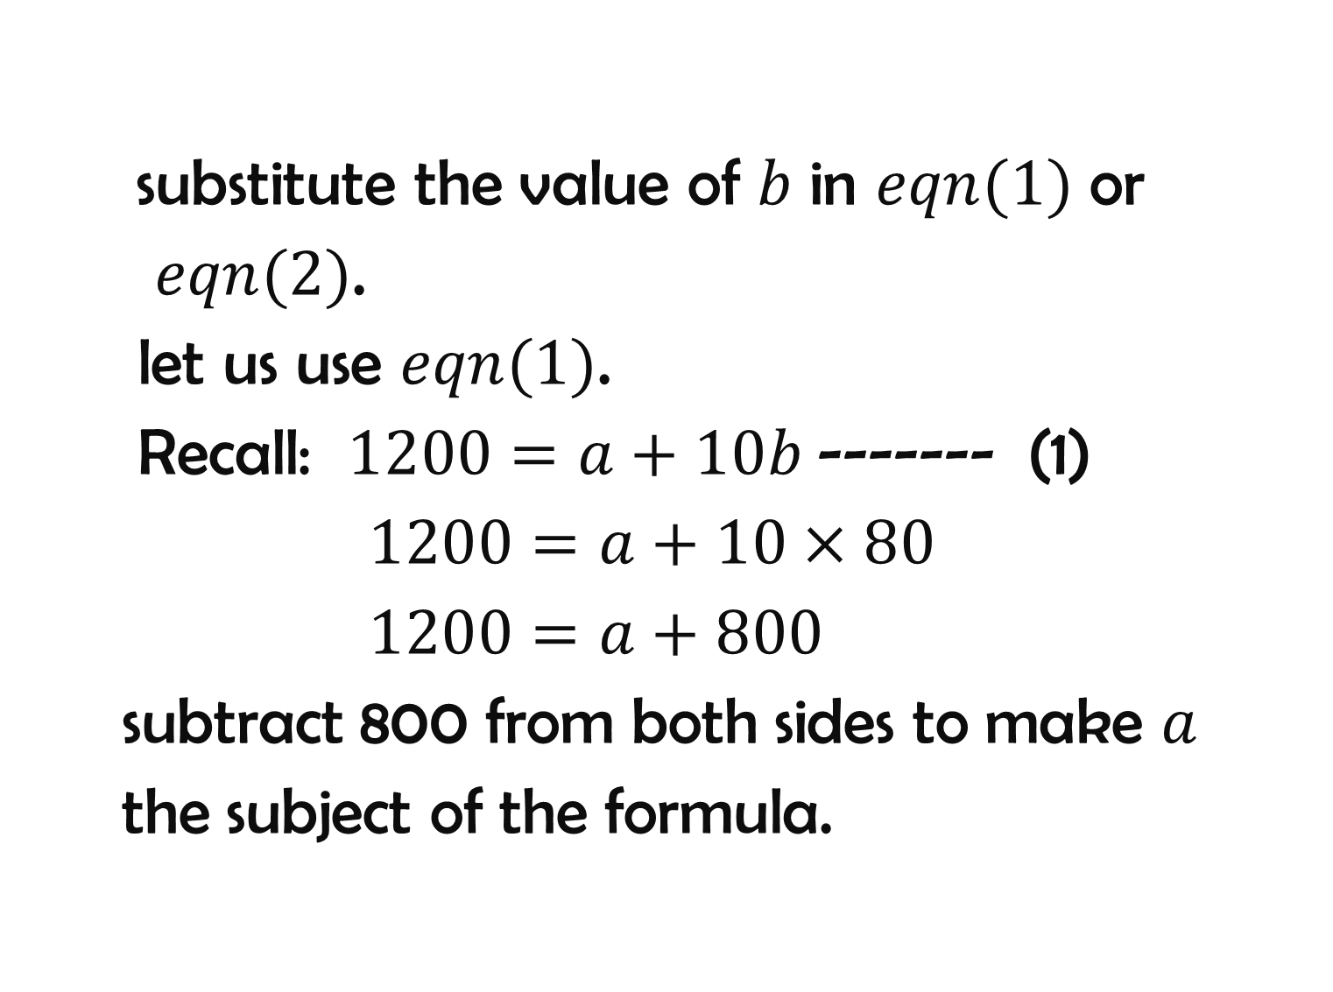
substitute the value of $b$ in $eqn(1)$ or
$eqn(2)$.
let us use $eqn(1)$.
Recall: $1200=a+10b$------- (1)
$1200=a+10×80$
$1200=a+800$
subtract 800 from both sides to make $a$
the subject of the formula.

Slide 8
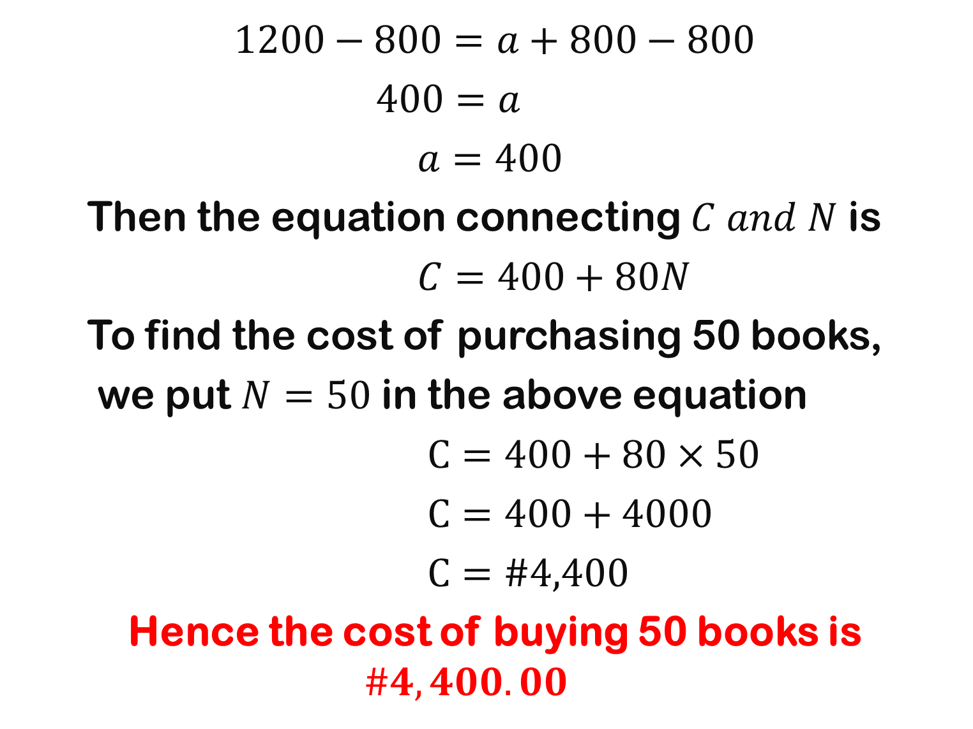
$$1200−800=a+800−800$$
$400=a$
$a=400$
Then the equation connecting $C and N$ is
$C=400+80N$
To find the cost of purchasing 50 books,
we put $N=50$ in the above equation
$C=400+80×50$
$C=400+4000$
$C=\#4,400$
Hence the cost of buying 50 books is $\#4,400.00$

Slide 9

assignment
1). A is partly constant and partly varies as B.
When $B=14, A=14$ and when $B=6,$
$A=20$. Find A when B=3
2). A is partly constant and partly varies as the
square of B. When $B=1, A=4\frac{1}{4},$ and when
$A=196\frac{1}{4},B=7$. Find the equation
connecting $A$ and $B$.

Slide 10

3). C is partly constant and partly varies directly with
D and inversely with E. $C=2\frac{2}{3} when D=8,$
$E=4 and C=1 when D=3, E=9.$ Find
$C when D=2, E=6.$
4). An examination fee is partly constant and
partly varies with the number of subjects
entered. When the examination fee is
$\#3500$ three subjects are entered. When the fee
is $\#5,500$, five subjects are entered. Find the number
of subjects entered if the fee is $\#6,500.$

Slide 11
Additional study
Study joint variation

